Slide 1
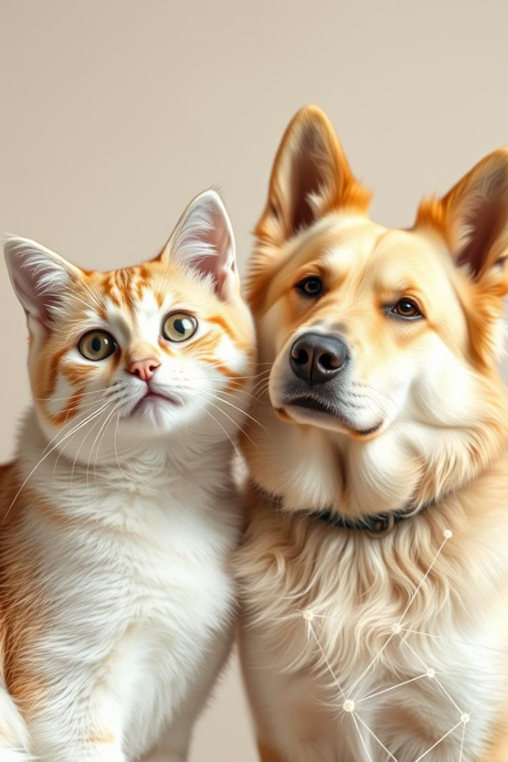
PowerPoint Slide Deck: Task 2 - Cat vs Dog Classifier using CNN
SS

Slide 2
Slide 1: Title Slide
Project Title:
Cat vs Dog Image Classifier
Subtitle:
Using Convolutional Neural Networks (CNN) in Python
Presented by:
Syed Shahid
Organization:
SLASH MARK IT Solutions
Date:
17/06/2025

Slide 3
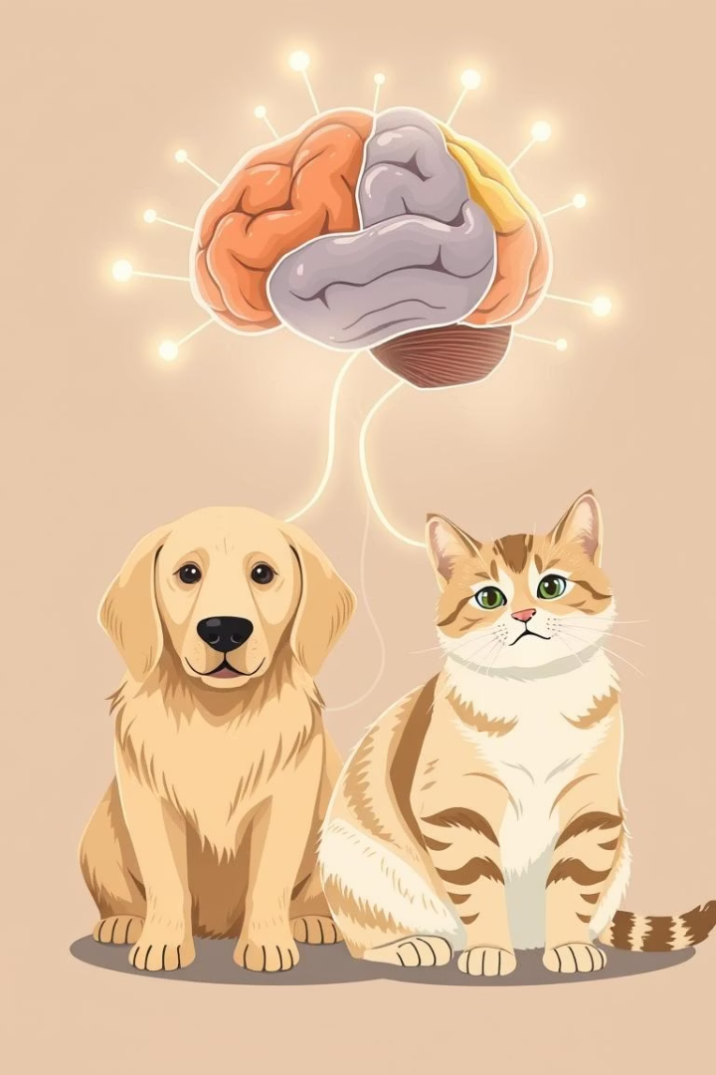
Slide 2: Introduction
Objective:
To build a model that classifies images of cats and dogs.
Background:
CNNs are powerful tools for image classification and are widely used in computer vision applications.

Slide 4
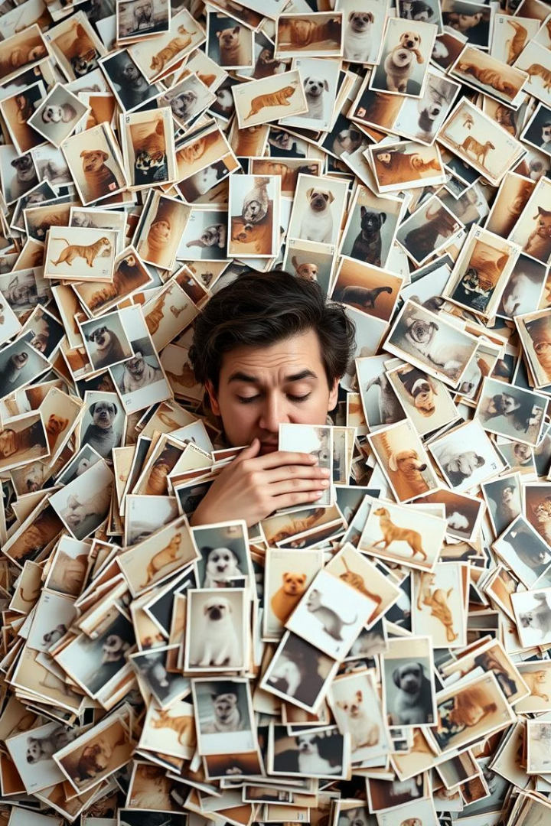
Slide 3: Problem Statement
Manual classification of images is time-consuming and inefficient.
This project aims to automate the classification using a CNN-based model.

Slide 5
Slide 4: Project Scope
Key Deliverables:
Constraints:
Assumptions:
Trained CNN model
Small dataset
Clear images of cats and dogs
Preprocessed image dataset
Limited to binary classification
Test prediction function

Slide 6
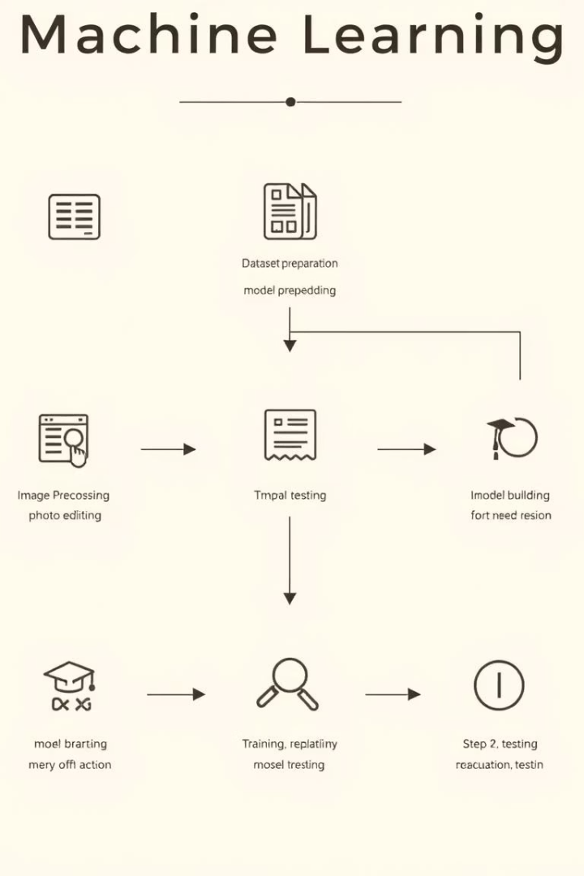



Slide 5: Methodology/Approach
Dataset:
Images of cats and dogs
Tools:
Python, Google Colab, TensorFlow, Keras
Steps:
Prepare and upload dataset
Preprocess images using ImageDataGenerator
Build CNN model
Train and evaluate model
Test on new image

Slide 7
Slide 6: System Design and Architecture
Input Image
Preprocessing
CNN Model
Dense Layers
Output

Slide 8





Slide 7: Key Features/Modules
Manual dataset creation and upload
Image resizing and normalization
CNN model architecture (Conv2D, MaxPooling, Flatten, Dense)
Prediction output on new images

Slide 9
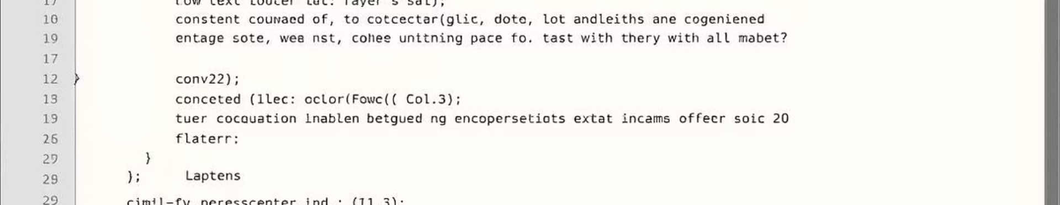
Slide 8: Implementation
Platform:
Google Colab
Programming Language:
Python
Libraries Used:
TensorFlow, Keras
Code Snapshot:
CNN model: 2 Conv2D layers, Flatten, Dense(128), Output(sigmoid)

Slide 10
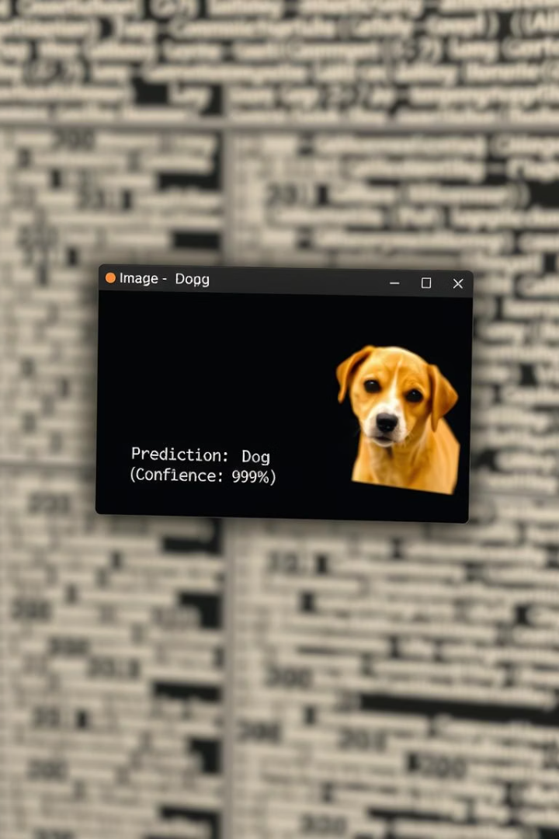
Slide 9: Testing
Manual test image uploaded
Model successfully predicts the image label

Slide 11
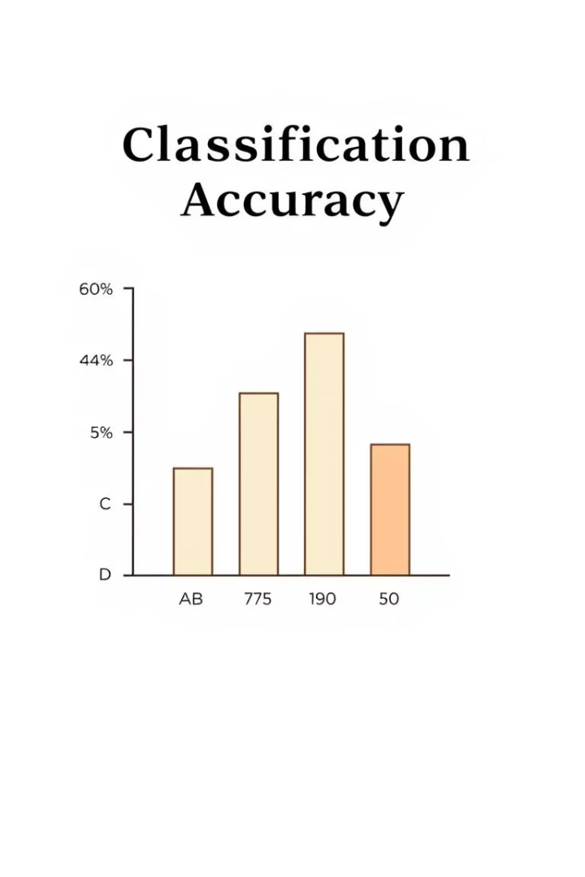
Results and Outcomes
Achieved ~85% accuracy on small dataset
Correctly classified most test images
[Insert Accuracy Graph or Chart]
SS
by SYED Shahid

Slide 12




Challenges and Solutions
Dataset size was small
Used data augmentation
Colab uploads were slow
Used zipped folders
Understanding model layers
Referred TensorFlow documentation

Slide 13
Conclusion and Future Scope
Conclusion:
Future Scope:
Successfully built a working cat vs dog classifier
Add multi-class classification
Demonstrated effective use of CNNs
Deploy as web app
Improve dataset and performance

Slide 14

Acknowledgments
Thanks to SLASH MARK IT Solutions
Thanks to mentors, peers, and support team

Slide 15

Contact Information
Name:
Syed Shahid
Email:
syedshahid7650@gmail.com
GitHub:
https://github.com/shahid8907503/cat-dog-cnn-classifier

